Slide 1
TensorFlow - MX Net - Keras
Péter Molnár 2018

Slide 2
Software Frameworks
Source: https://mc.ai/the-way-to-benchmark-your-deep-learning-framework-with-on-prem/

Slide 3
MNIST
The MNIST database (Modified National Institute of Standards and Technology database) is a large database of handwritten digits
Images are 28 x 28 pixels
The database has about 7,000 samples

Slide 4
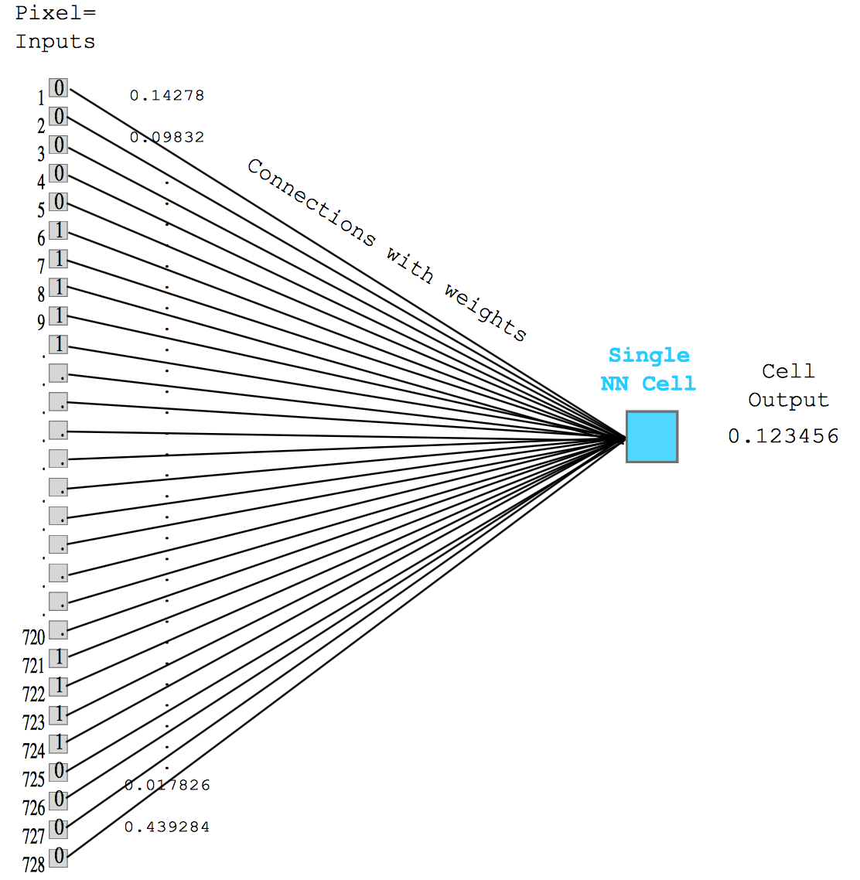
Classification → Regression
Each pixel represents as feature
Dependent variable is high if the feature vector represents a particular digit
y = X*W + b
with
X = (Nx784)
W = (784x10)
b = (10)
y = (10)

Slide 5
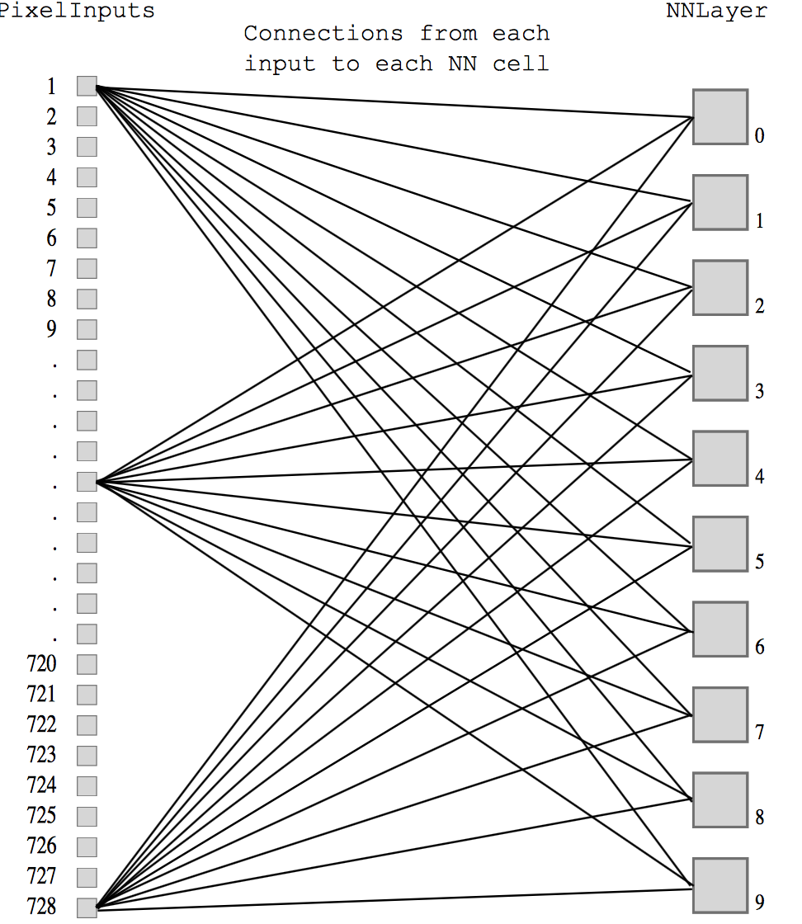
Classification → Regression
Each pixel represents as feature
Dependent variable is high if the feature vector represents a particular digit
y = X*W + b
with
X = (Nx784)
W = (784x10)
b = (10)
y = (10)

Slide 6
Regression
y = X*W + b
with
X = (Nx784), W = (784x10)
b = (10), y = (10)
X
*
W
+
y
b

Slide 7
TensorFlow: G
y = X*W + b
with
X = (Nx784), W = (784x10)
b = (10), y = (10)
X
Operator
Placeholder
*
Operator
W
+
y
Variable
Placeholder
Variable
b

Slide 8
Constants
Three main type of tensors in TensorFlow
tf.constant(): tensor with constant and immutable value.
After creation it has a shape, a datatype and a value.
#graph definition
a = tf.constant([[1,0],[0,1]], name="const_1") ... #graph evaluation inside session #constant are automatically initialized
a_val = sess.run(a)
#a_val is a numpy array with shape=(2,2)

Slide 9
Variables
tf.Variable(): tensor with variable (and trainable) values.
At creation time it can have a shape, a data type and an initial value. The value can be changed only by other TensorFlow ops.
#graph definition
a=tf.Variable([[1,0],[0,1]], trainable=False, name="var_1")
#graph evaluation inside session #manual initialization
sess.run(tf.global_variables_initializer()) a_val = sess.run(a)
#a_val is a numpy array with shape=(2,2)

Slide 10
Placeholders
tf.placeholder(): dummy tensor node. Similar to variables, it has shape and datatype, but it is not trainable and it has no initial value.
A placeholder it’s a bridge between python and TensorFlow, it only takes value when it is populated inside a session
#graph definition
a = tf.placeholder(tf.int64, shape=(2,2),name="placeholder_1")
...
#graph evaluation inside session #a takes the value passed by the feed_dict
a_val = sess.run(a, feed_dict={a:[[1,0],[0,1]]})
#a_val is a numpy array with shape=(2,2)

Slide 11
Switch to notebooks
https://github.com/kingmolnar/ImageAnalytics

